Slide 1
Reactive stream operator’s
Filter
Map
Flatmap
FlatmapMany
Concat
Merge
Zip

Slide 2
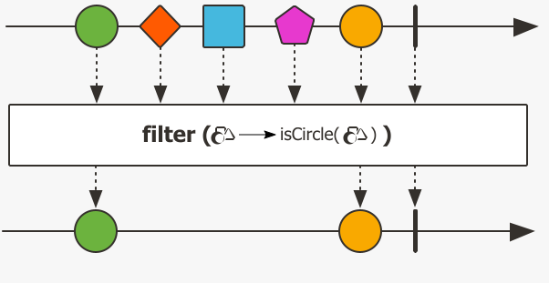
Filter stream operation
Filter the reactive stream depends on the condition.
Filter the that satisfies the predicate condition.

Slide 3
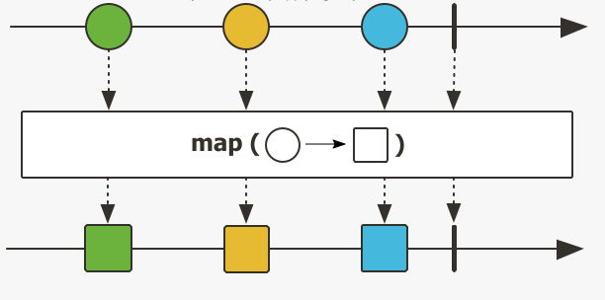
Map stream operation
Transform the items emitted by Flux/Mono from one form to another.
Map should be used when you want to do the transformation of an object /data in fixed time. The operations which are done synchronously to each item emitted.
Time taken more because it goes one by one element.

Slide 4
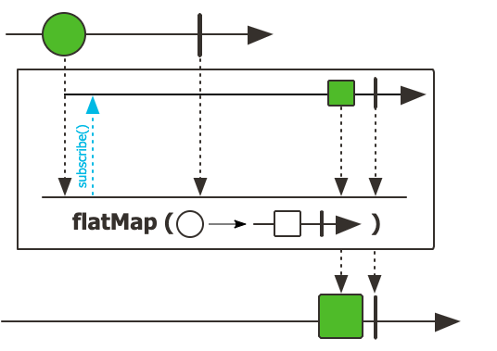
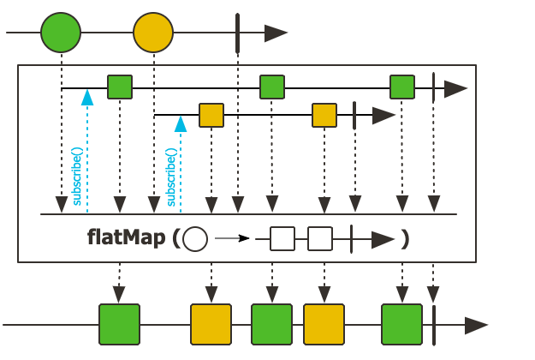
FlatMap stream operation
FlatMap should be used for non-blocking(Asynchronous) operations like DB/API call.
FlatMap method in Mono class returns Mono<T>.
FlatMap method in Flux class returns Flux<T>.

Slide 5
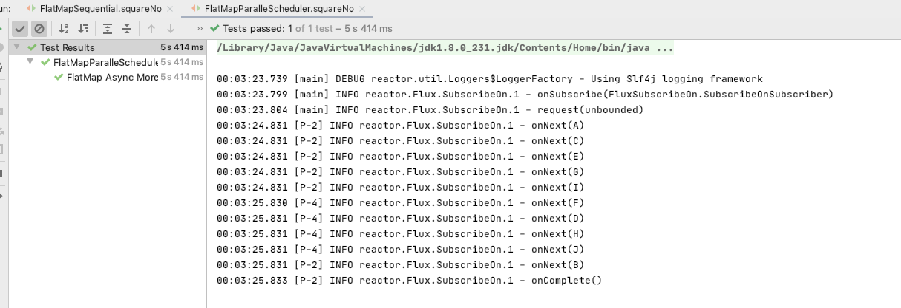
FlatMap stream operation
Time taken is less than Map function, since it’s Asynchronous.
When using Schedulers with FlatMap, then its more faster in terms of time.
When using Schedulers with FlatMap, Order of completion will not be guaranteed, so this where ConcatMap comes into picture.

Slide 6
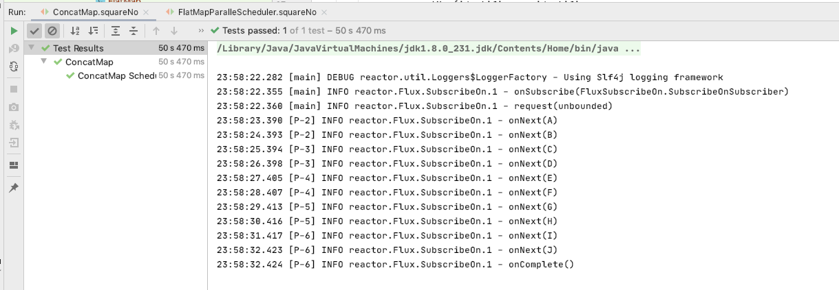
ConcatMap stream operation
ConcatMap is Similar to FlatMap.
ConcatMap is Asynchronous as same as FlatMap.
When using Schedulers with ConcatMap, Order of completion is guaranteed.
Since the Order is guaranteed it’s slower than FlatMap Scheduler.

Slide 7
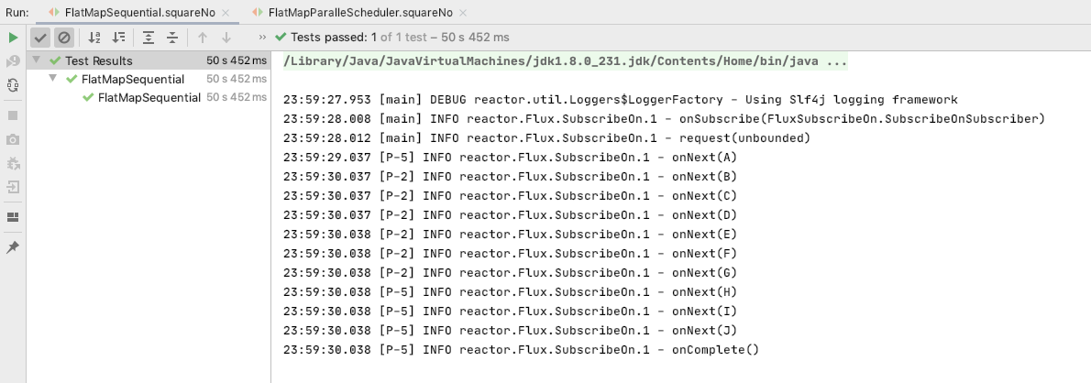
FlatMapSequential stream operation
FlatMapSequential is Similar to FlatMap.
FlatMapSequential is Asynchronous as same as FlatMap.
When using Schedulers with FlatMapSequential , Order of completion is guaranteed.
Order is guaranteed and also faster same as FlatMap Scheduler.
FlatMapSequential guaranteed the order and faster same as in FlatMap with Scheduler.

Slide 8
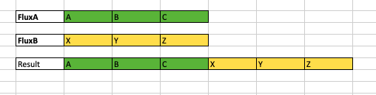
Concat stream operation
Concat is used to combine two or more number of Flux.
Lets consider a scenario FluxA needs to be combined with FluxB. Concat waits for FluxA to emits all it’s elements and puts the FluxB hold.
Once FluxA completes emitting all the elements, then Concat adds the FluxB to FluxA.
In such scenario FluxA might be slow in emitting the elements. so Concat will waits for FluxA to complete emitting then add FluxB to it here is where combining becomes slow.
Concat waits for each of the flux to complete emitting the elements, then it combine the next Flux.
Since it follows the waiting strategy order is maintained while combining as shown below.

Slide 9
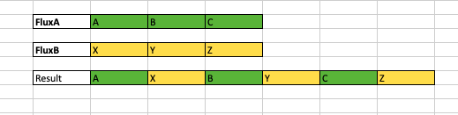
Merge stream operation
Merge is used to combine two or more number of Flux.
Lets consider a scenario FluxA needs to be combined with FluxB. Merge will start combining the elements from both FluxA and FluxB.
Merge will not wait for FluxA emit all of it’s elements. Who ever emits the elements it will start capturing it to Merge together, so its Faster than Concat but you can not expect the Order of FluxA + FluxB. The Result will be mixed up that u can’t predict the result order.

Slide 10
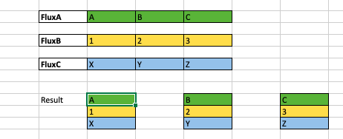
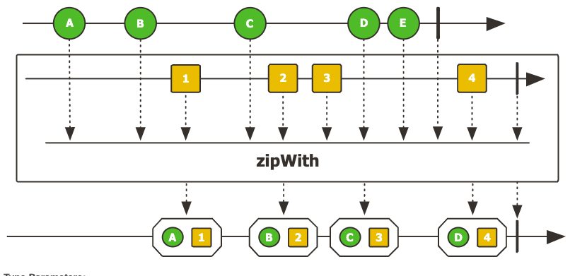
Zip stream operation
Zip is used to combine two or more number of Flux.
Zip will wait for each of the Flux to emit one element and start combining them.
Zip sources together, that is to say wait for all the sources to emit one element and combine these elements once into a Tuple. The operator will continue doing so until any of the sources completes. Errors will immediately be forwarded.
Below is the picture diagram.

